Slide 1
Smart Cart: Revolutionizing Retail with AI, ML and automation

Slide 2
Team Members ( Name & Registration Number )
NAME | REG NO
SREENIVASAN S | 21BEC0256
AMRIT ROUT | 21BEC0294
MANAS SINHA | 21BEC0327

Slide 3
Problem Statement (Aim or Motivation)
AutoBill is an AI-powered autonomous checkout system for retail stores, integrating computer vision and machine learning to enhance the shopping experience.
The system ensures a faster checkout process, reducing human interactions in the store to prioritize the safety of shoppers and employees during the pandemic.
AutoBill employs computer vision and machine learning for visual item detection, and a weight sensor measures the weights of items placed on the counter-top.
Once items are identified, they are automatically added to the cart, and the system generates an instantaneous bill with a QR code for payment, allowing users to complete transactions efficiently.

Slide 4
Proposed Idea (Novelty of the project work)
Integration of Computer Vision and Machine Learning: The project leverages the powerful combination of computer vision and machine learning to create an autonomous checkout system. This integration enables the system to visually detect and identify items placed on the counter, enhancing the overall shopping experience.
Real-time Checkout and Instant Billing: AutoBill offers a novel approach to the checkout process by providing real-time item identification and instantaneous billing. This eliminates the need for traditional checkout queues, saving time for both shoppers and store personnel.
Contact-free Checkout for Safety: In response to the ongoing pandemic, AutoBill prioritizes safety by minimizing human interactions in the store. The contact-free checkout process reduces the risk of virus transmission, contributing to a safer shopping environment for both shoppers and employees.
Edge Impulse for Machine Learning on Edge Devices: The project utilizes Edge Impulse, a leading development platform for machine learning on edge devices. This choice allows for efficient deployment of machine learning models on devices like the Raspberry Pi 3B, bringing intelligence to the edge and minimizing reliance on cloud services.
Data Acquisition and Labeling Automation: The data acquisition process involves capturing a diverse range of product images and uploading them to Edge Impulse for training the machine learning model. The project also incorporates automation in labeling through an object tracking algorithm, streamlining the process of preparing the dataset for training.
Transfer Learning for Efficient Model Training: AutoBill employs transfer learning to enhance the efficiency of model training. By leveraging a well-trained base model, the project accelerates the training process, resulting in more reliable models with reduced training times and the ability to work with smaller datasets.

Slide 5
Beneficiaries of the proposed solution
Retail Store Owners:
Increased Efficiency: AutoBill can significantly reduce checkout times, leading to higher customer throughput and improved operational efficiency for retail store owners.
Cost Savings: By automating the checkout process, store owners may be able to reduce labor costs associated with traditional cashier roles.
Retail Store Employees:
Safer Working Environment: With AutoBill minimizing human interactions during checkout, retail employees may experience a safer working environment, especially during the ongoing pandemic.
Focus on Customer Service: Automated checkout allows employees to focus on other customer service aspects, such as addressing customer queries and ensuring a pleasant shopping experience.
Shoppers:
Faster Checkout: Shoppers benefit from a quicker and more convenient checkout process, reducing the time spent in lines and improving overall shopping experience.
Reduced Contact: During the pandemic, shoppers may appreciate the reduced need for direct human interactions at the checkout counter, contributing to a safer shopping environment.

Slide 6
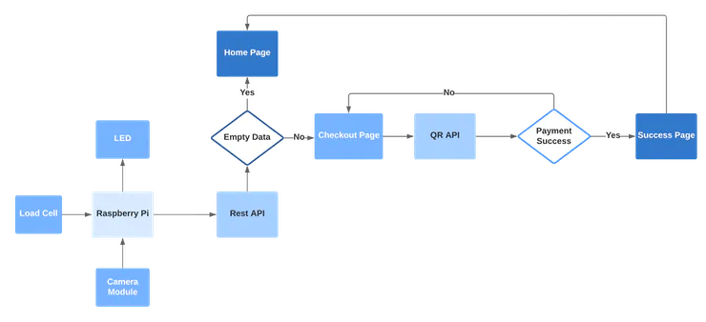
Overall System Flow Diagram (block diagram)

Slide 7
Hardware & Software Details
Hardware Components:
Raspberry Pi 3 Model B
Seeed Studio Weight Sensor (Load Cell) 0-3kg
SparkFun Load Cell Amplifier - HX711
5V 2A power supply
REES52 5 Megapixel 160° degrees Wide Angle Fish-Eye Camera
WS2812B RGB Led Strip
TaydaElectronics DC POWER JACK 2.1MM BARREL-TYPE PCB MOUNT Plywood
Software Components:
Edge Impulse Studio
Raspberry Pi Raspbian
Microsoft Visual Studio code

Slide 8


